Slide 1
MATH 285 Week 1,2 D2

Slide 2
Administra
Hand in homework and grab the old one on Friday. (You can apply to extended the deadline to me if necessary.)
Solution presentation makes up to 5% of the extra credit.
It's okay if you find the slides are too hard (so do I), but try your best to solve the homework with the help of textbook.

Slide 3
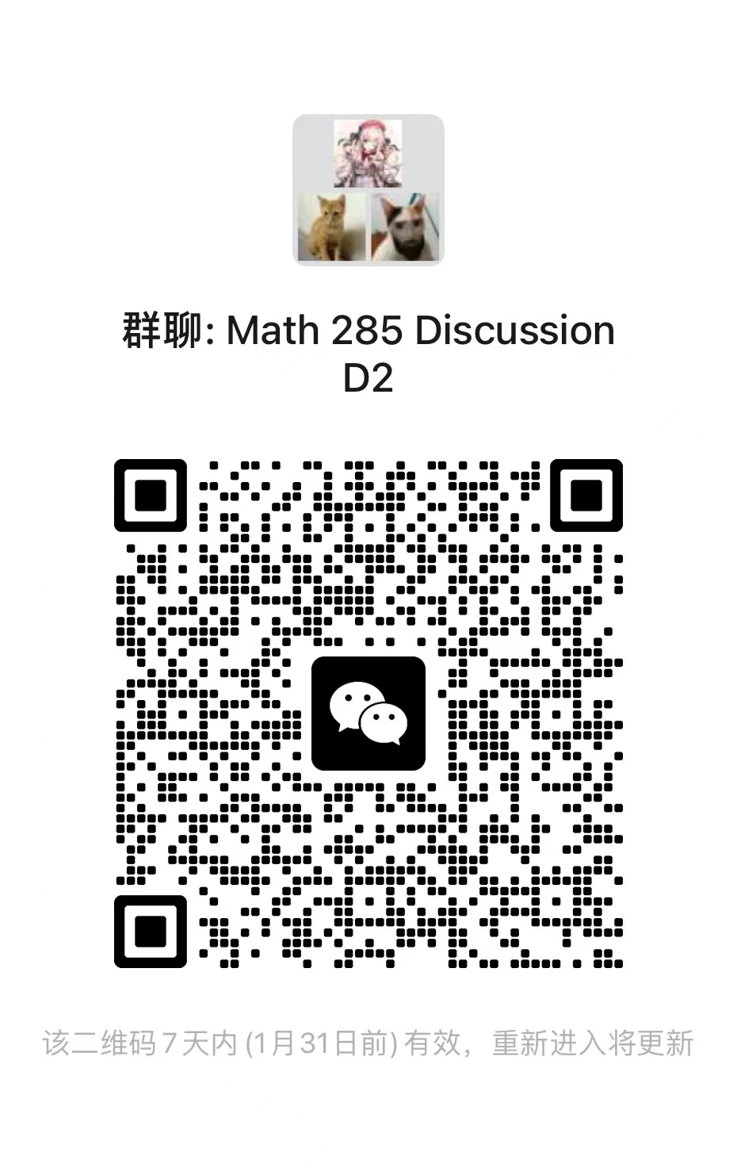

Slide 4
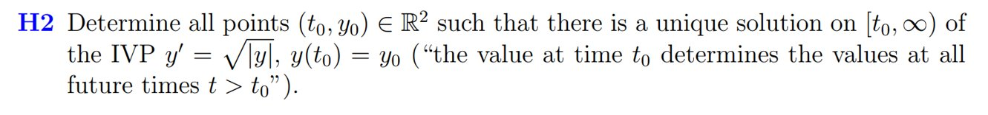




Slide 5
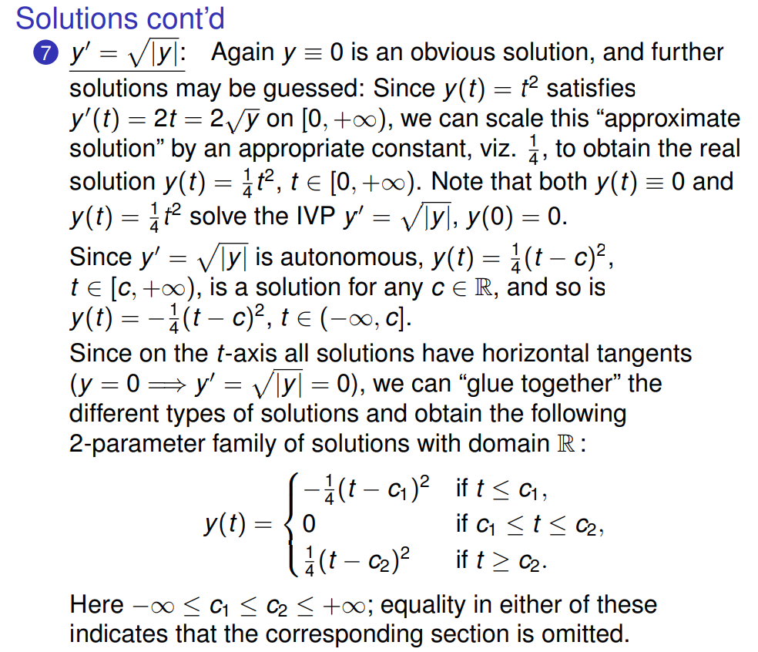

Slide 6
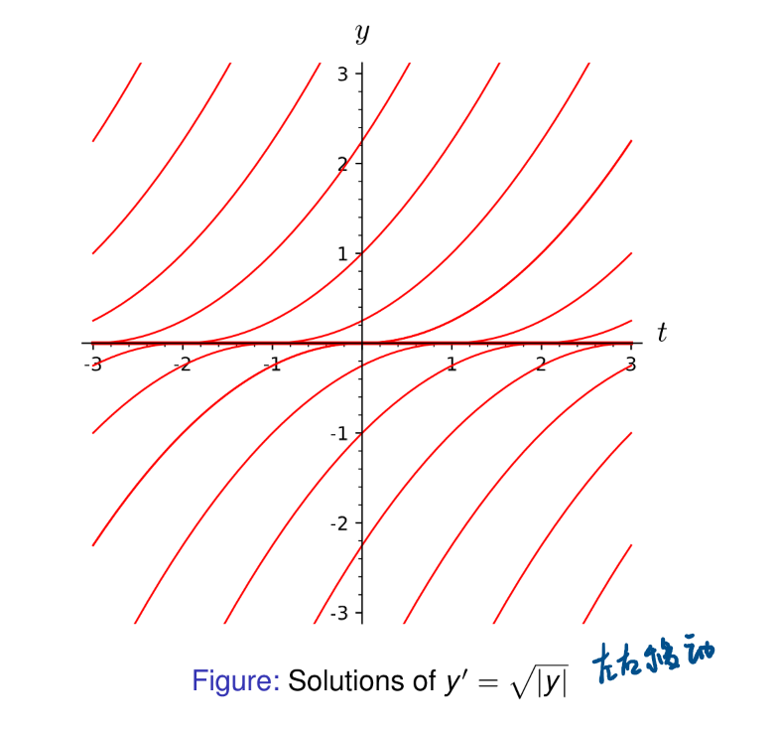
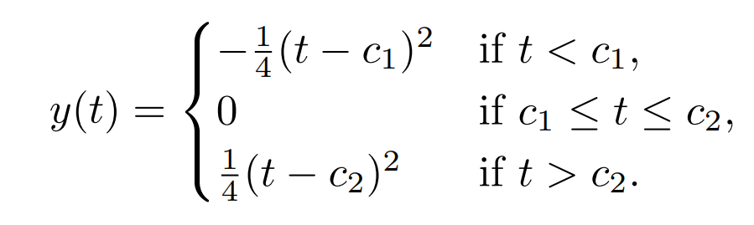

Slide 7
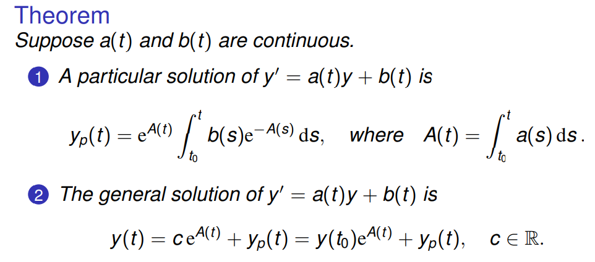
First-order Linear ODE

Slide 8
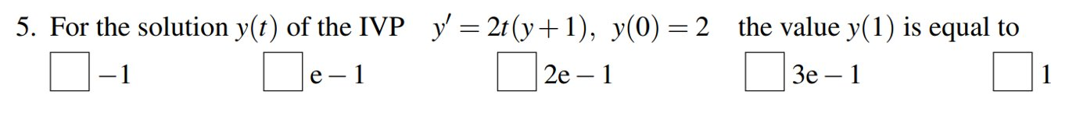
Solution = General solution + Particular solution

Slide 9
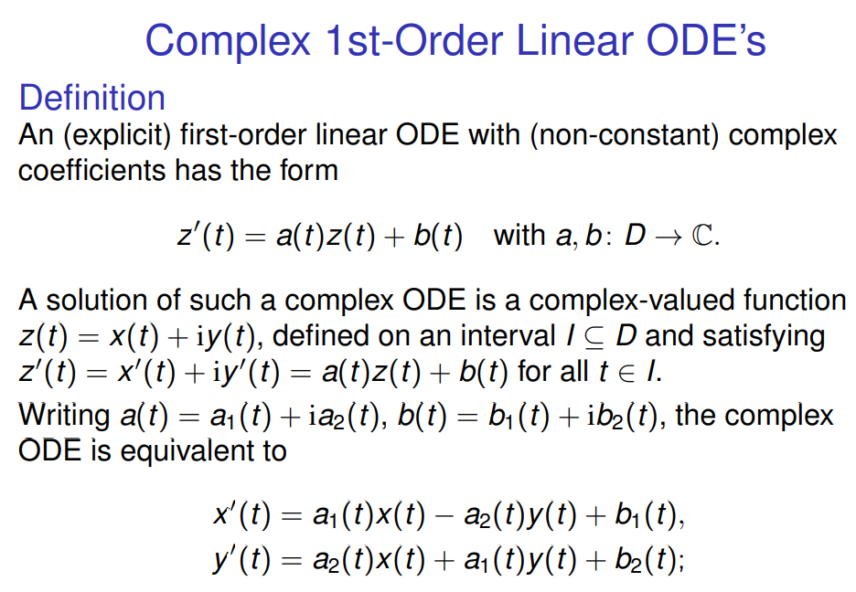

Slide 10

Example (from former TA)

Slide 11
